Slide 1
Spatial Analysis Intro GIS and Spatial Statistics
Gyuhwan Kim

Slide 2
What is Spatial Analysis?
Quantitative Analysis of Spatial Data: 5 types
Exploratory Spatial Data Analysis (ESDA)
ESDA with statistics
ESDA with econometrics
ESDA with optimization
ESDA with visualization techniques

Slide 3
Why GIS/Spatial Analysis for Social Science?
Most of social science issues (e.g. social, political, economic, environmental and institutional factors) are associated with various characteristics linked to geographic locations and show unique spatial patterns
Outcomes of public and private programs and policy could vary by spatial locations
Thus, holistic, ecological, and multi-level approach would be needed to guide informed decision-making process, which requires systematic integration of data for various spatial aspects existing at a certain geographical unit.
GIS/Spatial Analysis is an integrative technology-based tools for collecting, storing, managing, exploring, analyzing, mapping and visualizing information linked to geographic locations

Slide 4
Areas of Social and Public Policy: Could GIS and Spatial Analysis be Useful?
Politics and elections
Transportation and service routing
Housing management
Public service delivery and infrastructure management
Tax maps and law enforcement
Land use planning
Parks and recreation
Economic/community development
Emergency management
Crime and public safety
Environmental monitoring and management
Health and social services
Anything else? In your area?

Slide 5
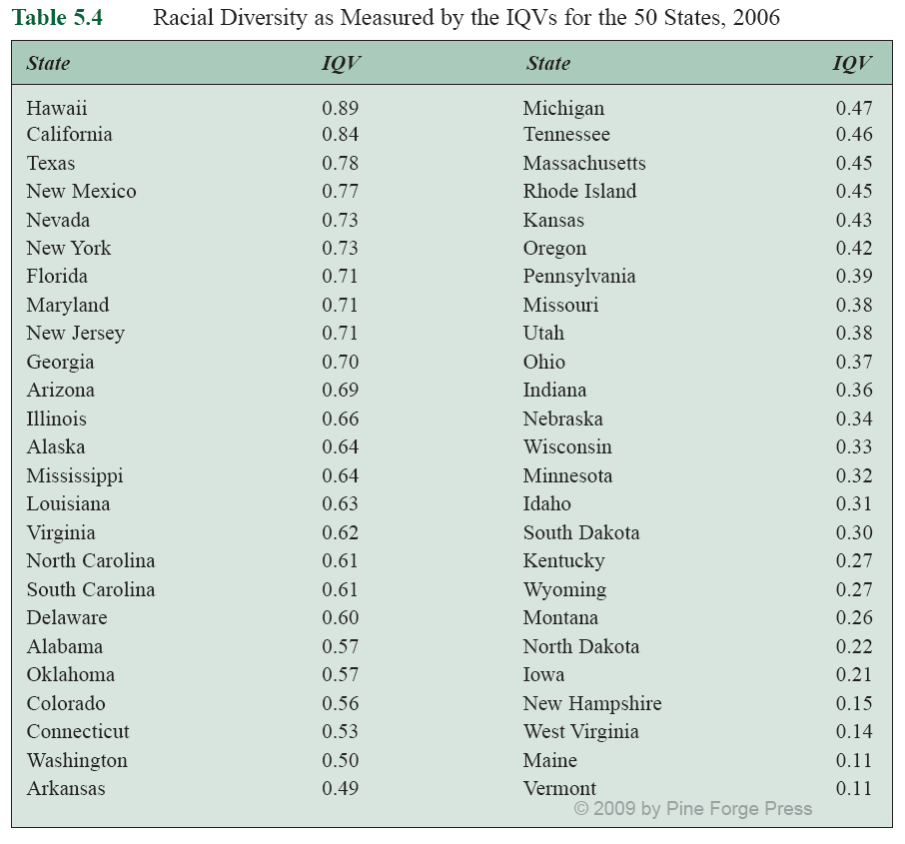
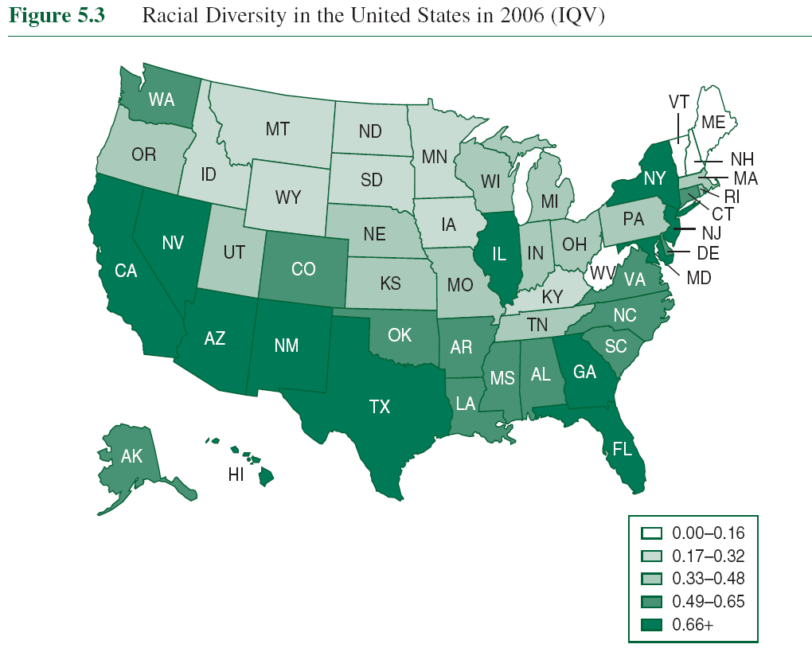
Quick and Simple Example: Which State in the U.S. is More Diverse?

Slide 6
What Makes Spatial Statistics Critical?
It plays a role if the spatial process is not random (clustered, dispersed, etc.)
Then, specific methods that use distance, space, and spatial relationships would be needed as part of the math for their computations.
It focus on both spatial distribution and spatial pattern:
Measuring Geographic Distributions
Analyzing Patterns and mapping clusters
Why use spatial statistics? To help assess patterns, trends, and relationships
Better understanding of geographic phenomena
Pinpoint causes of specific geographic patterns
Make decision with high level of confidence
Summarize the distribution in a single number

Slide 7
Spatial Analysis : Intro
Gyuhwan Kim

Slide 8
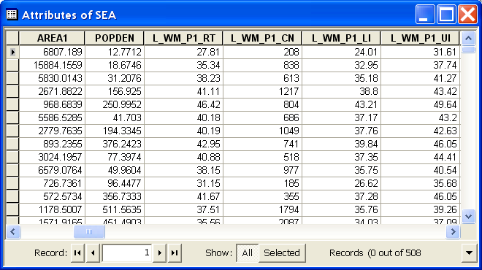

Spatial Data
Spatial data
Location (coordinates)
Attributes (variables)
Data matrix
$$X=\left(\begin{matrix}X_{1}\left(s_{1}\right) & X_{2}\left(s_{1}\right) & ⋯ & X_{p}\left(s_{1}\right) \\ X_{1}\left(s_{2}\right) & X_{2}\left(s_{2}\right) & ⋯ & X_{p}\left(s_{2}\right) \\ ⋮ & ⋮ & ⋱ & ⋮ \\ X_{1}\left(s_{n}\right) & X_{2}\left(s_{n}\right) & ⋯ & X_{p}\left(s_{n}\right)\end{matrix}\right)$$

Slide 9
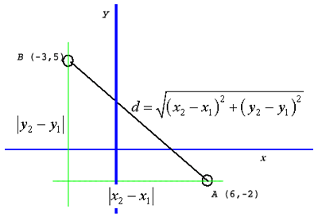
Spatial is special
3 special aspects of spatial data
Distance
Adjacency
Interaction

Slide 10
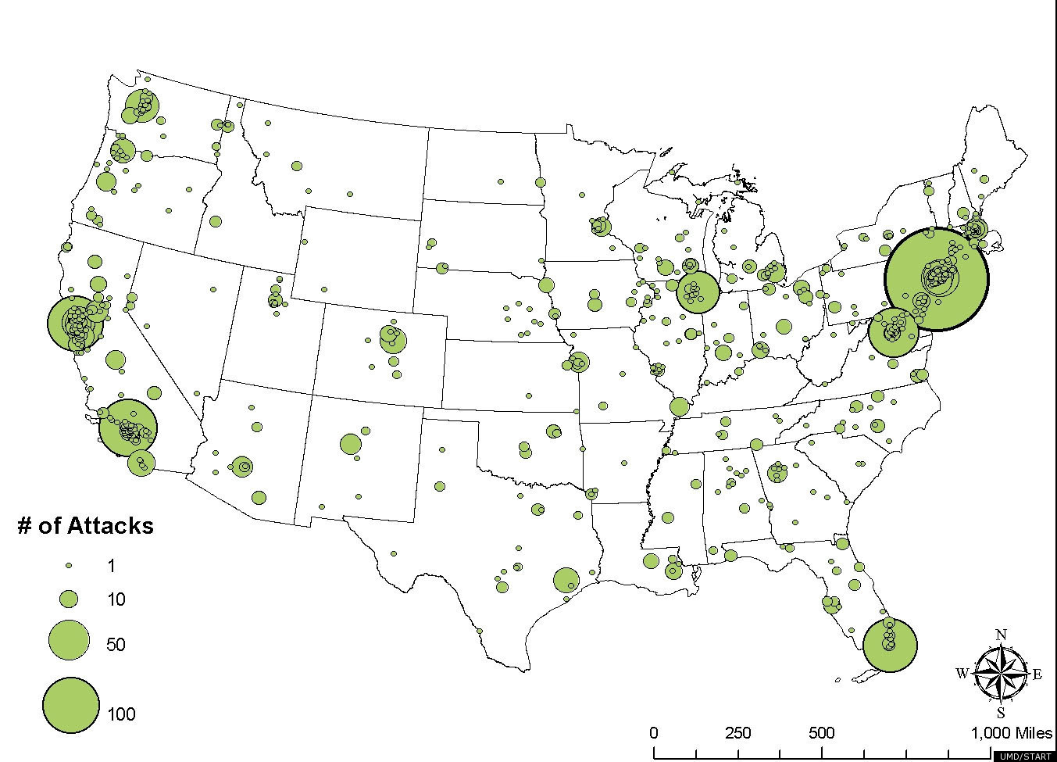
Reason for spatial analysis
Three questions concerning locations
How much is where?
Locations & attributes
E.g. income distributions in the U.S. or Korea

Slide 11
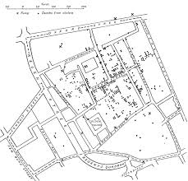
Reason for spatial analysis
Three questions concerning locations
How are things distributed in space?
only location information is available.
E.g. where a rare disease can be found

Slide 12
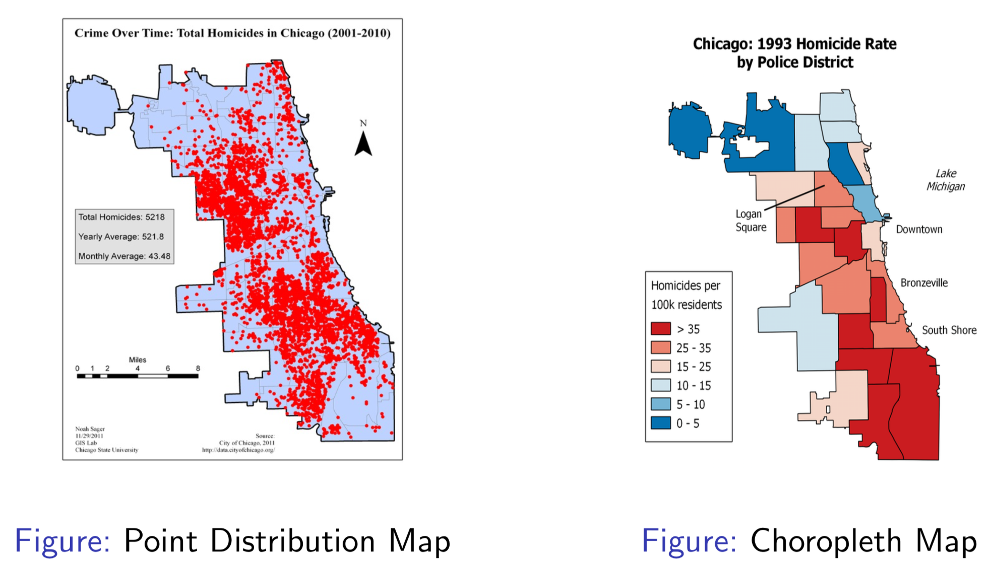
Reason for spatial analysis

Slide 13
Are things correlated over space?
Three questions concerning locations
Are things correlated over space?
Spatial autocorrelation
Observations in space are NOT independent
First law of geography by Tobler
“Everything is related to everything else, but near things are more related than distant things”
Observations in close spatial proximity tend to be more similar than observation are more spatially separated.

Slide 14
Defining Spatial autocorrelation
Correlation: degree of relative correspondence
Positive: similar values cluster together on a map
Negative: dissimilar values cluster together on a map

Slide 15
Defining Spatial autocorrelation

Slide 16
Spatial Analysis
Spatial analysis
Modifications, extensions, and additions to statistical techniques that explicitly consider the important locations or spatial arrangements
Includes any investigation in which the data’s spatial locations play a role in a probabilistic or statistical analysis

Slide 17
Types of Spatial Analysis Methods
Visualizing spatial data
Graphical views of data
Display of raw data, intermediate and final results
Exploring spatial data
Summaries and descriptions
Investigating map patterns and relationships
Modeling spatial data
Specification of a statistical model
Estimation of parameters
Hypothesis testing

Slide 18
What is needed for spatial analysis
Location information of spatial phenomena: A map
An attribute dataset
Locational tags linking the attributes and locations
Spatial proximity
Weight matrix

Slide 19
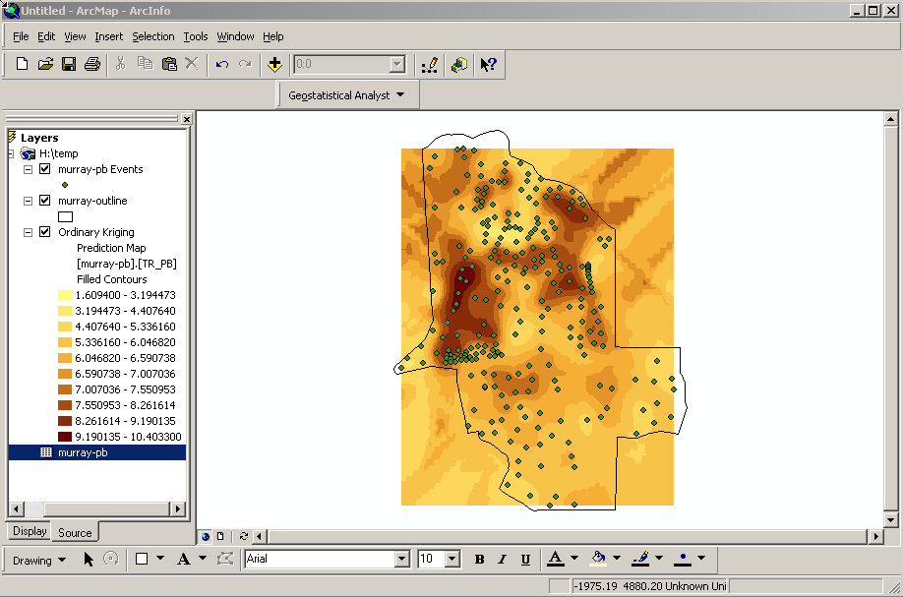
3 Classes of Spatial Data
Geostatistical Data
Spatially continuous data
Attributes are random variables of interest
“Continuous” means attributes can be observed everywhere (infinite locations)
But, attributes are observed on finite sample points
E.g. precipitation, elevation

Slide 20
3 Classes of Spatial Data
Lattice Data
Area data
Attributes are random variable of interest
Attributes exist and are observed on finite locations
Area can be regular or irregular
E.g. US state boundaries, Remote sensed images

Slide 21
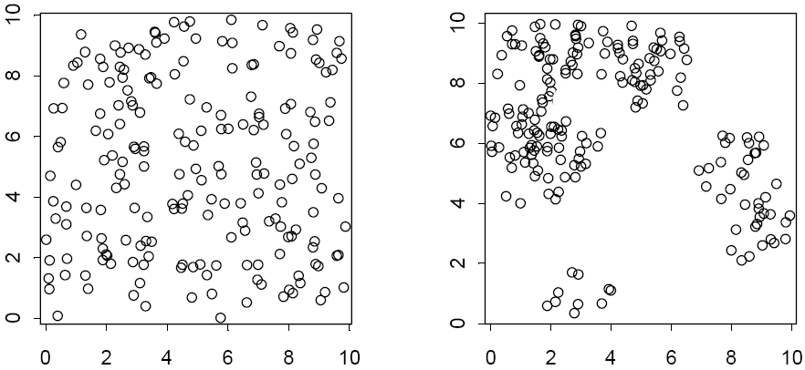
3 Classes of Spatial Data
Point Patterns Data
The locations are random variables of interest
In many cases, there is no attribute involved

Slide 22
Spatial Weights
Calculation of Wij (spatial weights matrix), indexing the relative location of all points i and j, is the primary step to all spatial autocorrelation analyses
Different methods of calculation of Wij potentially result in different values for the measures of autocorrelation and different conclusions

Slide 23
Spatial Weights Matrix
How to create a spatial weights matrix?
By contiguity/adjacency
By distance
By other attributes
Weights based on contiguity/adjacency
If zone j is adjacent to zone i, the interaction receives a weight of 1, otherwise it receives a weight of 0 and is essentially excluded
Weights based on distance
Uses a measure of the actual distance between points or between polygon centroids

Slide 24
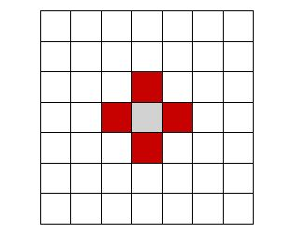
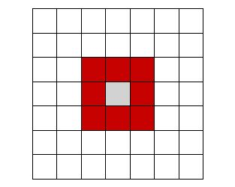
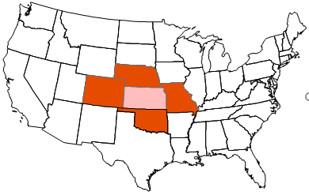
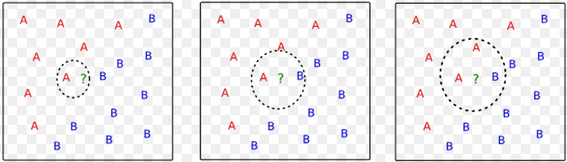
Criteria for Weights Based on Contiguity
For Regular Polygons
Rook: sharing a boundary
Queen: sharing a boundary or a point
For Irregular polygons
All polygons that share a common border
All polygons that share a common border or have a centroid within a circle defined by the average distance to centroids of polygons that share a common border
For points
Up to kth nearest neighbors

Slide 25
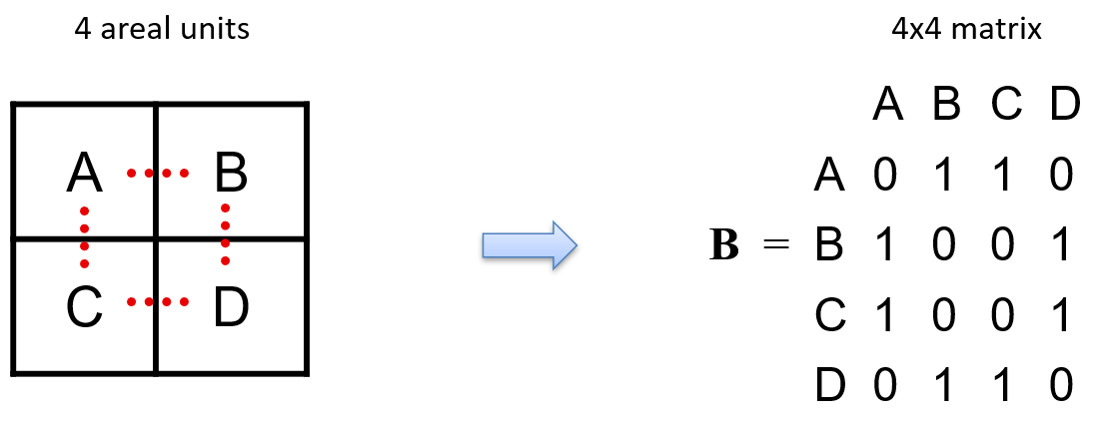
Weights based on Lagged Contiguity
Commonly, it is expressed in a matrix form
Many ways to define spatial proximity
Select the adjacency/contiguity criteria
Construct n x n weights matrix with 1 if contiguous, 0 otherwise

Slide 26
Weights based on Lagged Contiguity
We can also use adjacency matrices which are based on lagged adjacency
We can define an “order of contiguity” matrices:
1st order (immediate neighbors)
2nd order (neighbors of neighbors)
If lower-order neighbors are not included while higher order neighbors are included, donut effects exist.

Slide 27
Exploratory Spatial Data Analysis
Extension of exploratory data analysis (EDA) to detect spatial properties of data
EDA
consists of a collection of descriptive and graphical statistical tools
intended to discover patterns in data and suggest hypotheses
ESDA links numerical and graphical procedures with the map

Slide 28
ESDA Basics
Visual tools for non-spatial analyses
Univariate
Multivariate
Visual tools for spatial analyses
General trends
Spatial autocorrelation
Spatial outliers

Slide 29
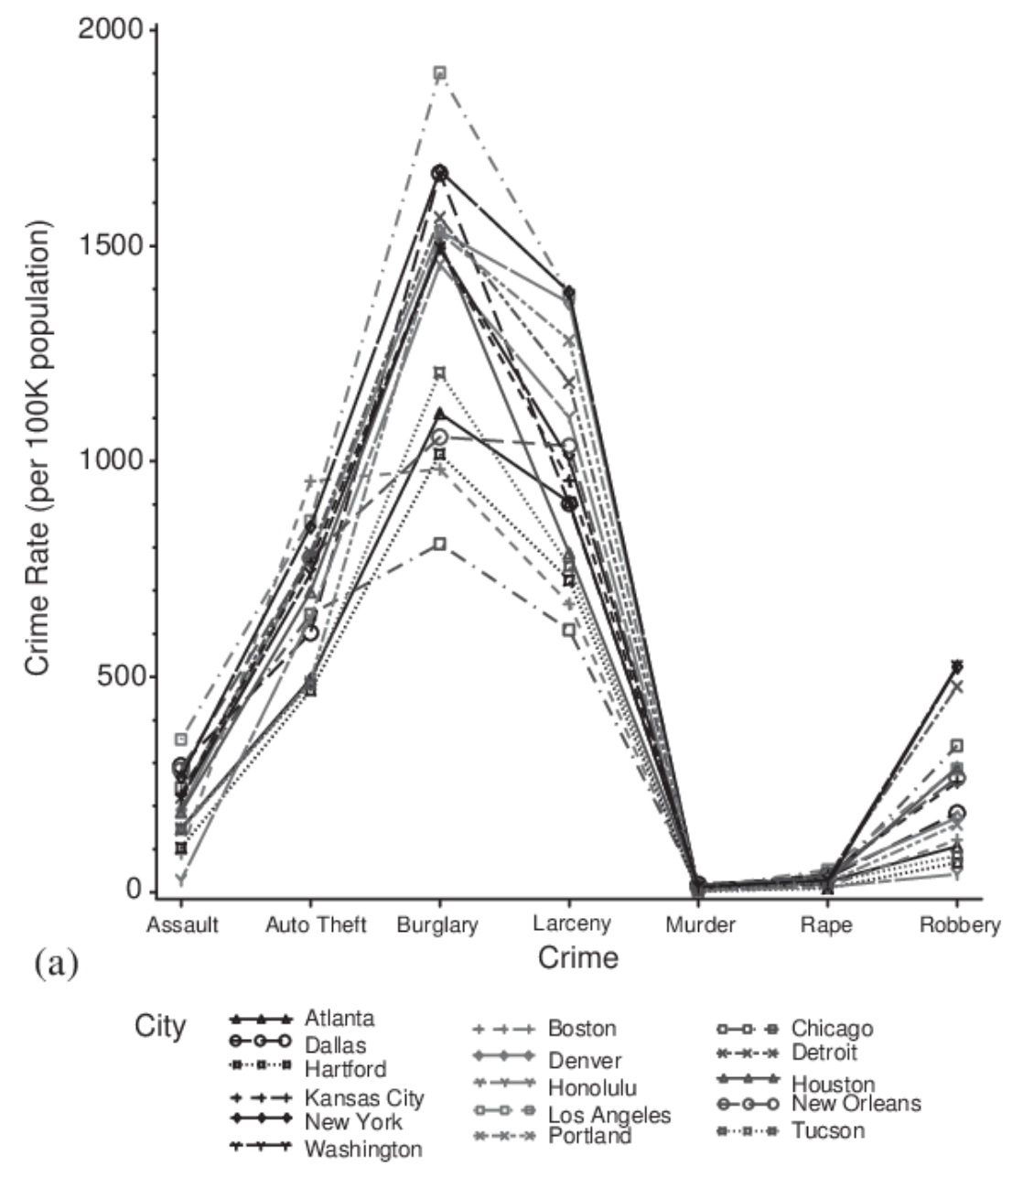
Visual tool for non-spatial analyses
Univariate
Histogram
Box plot
Multivariate
Scatter plot
Line plot

Slide 30
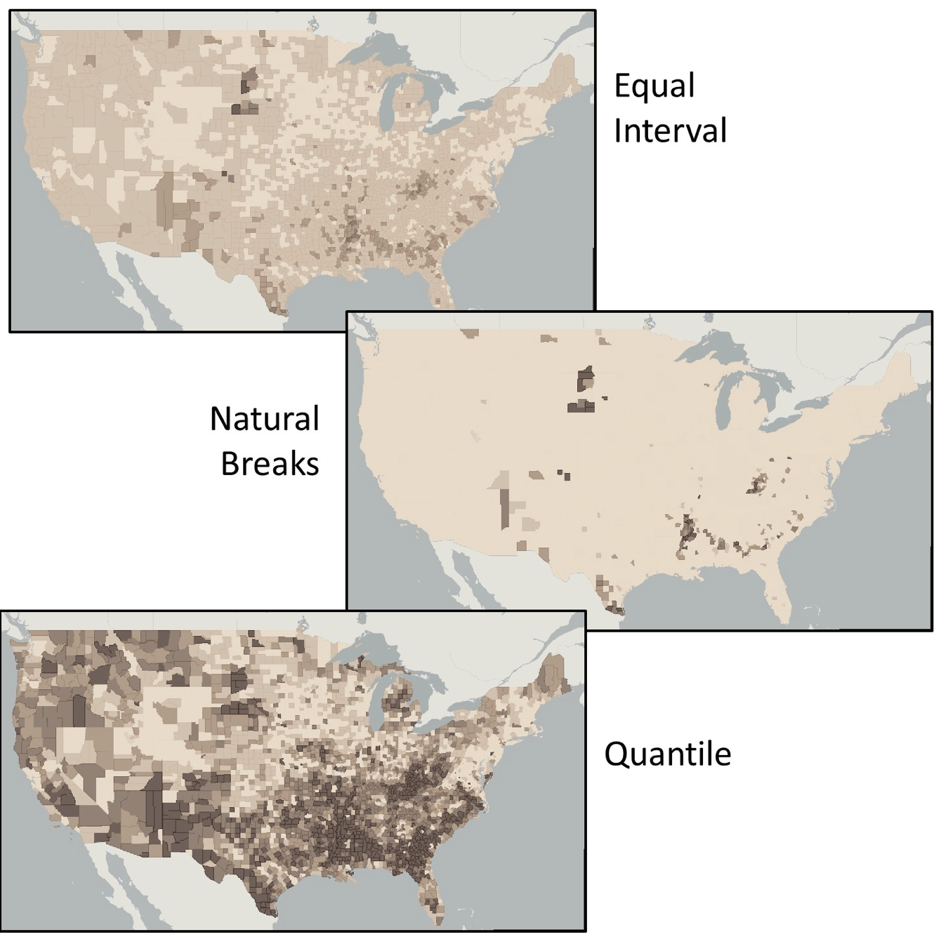
Visual tools for spatial analyses
Grouping
Equal intervals
Quantiles
Standard deviation
Be careful!
Color maps can lead to wrong interpretation

Slide 31
Spatial Outliers

Slide 32
Geographic Information system : Intro
Gyuhwan Kim

Slide 33
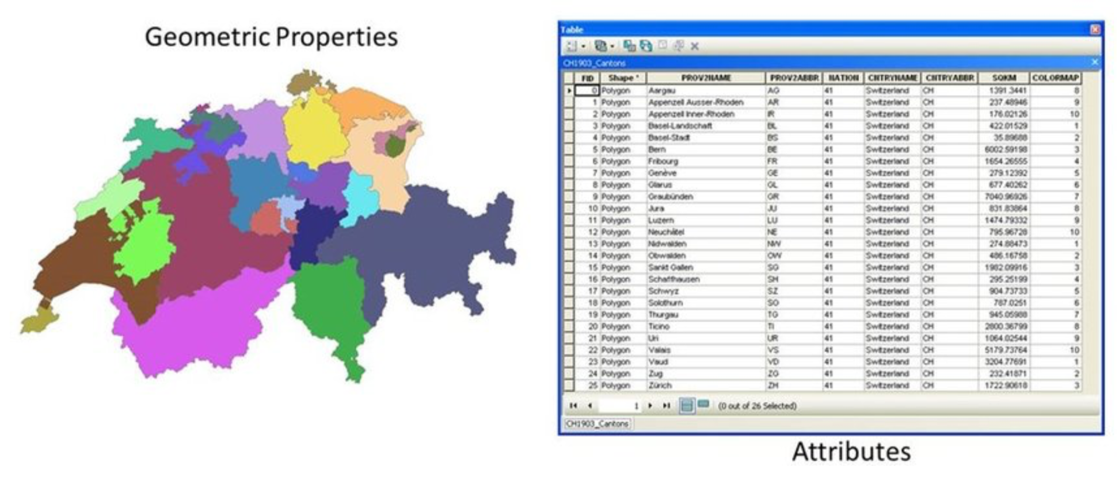
Geographic Data: 2 Components
Geometry: Shape of an object
Attributes: Tabular data describing an object

Slide 34
Frequent Questions with Geographic Data
How do I get it?
Acquire from existing sources
Create your own (geocoding & digitizing)
Spatial join would be needed
CRS would need to be matched
What is it?
Vector
Raster

Slide 35
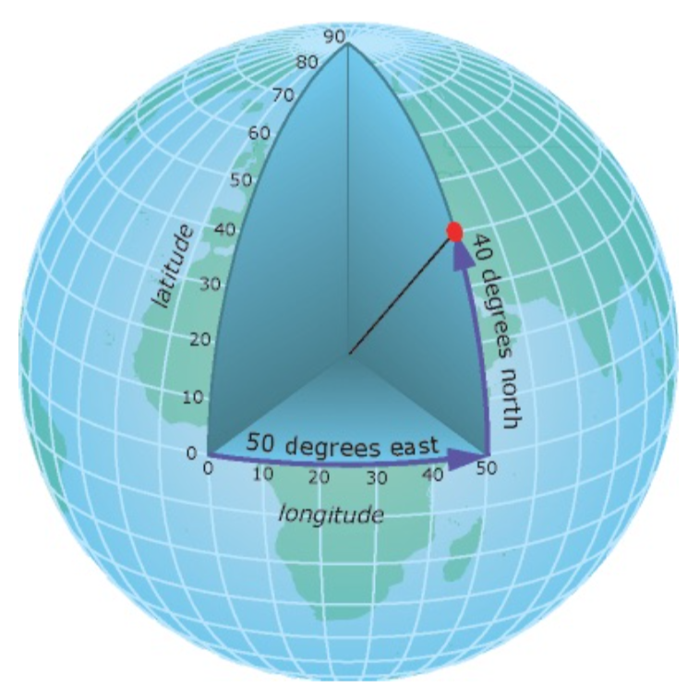
Coordinate Reference System (CRS)
Geographic CRS
WGS84 (UTM Standard, used in GPS, lat & long; EPSG 4326)
Latitude: northern hemisphere (0~90 degree), southern hemisphere (-90~0 degree)
Longitude: east and west from the Prime Meridian
On equator: 1 degree = 111km, 1 second = 30.87m
Projected CRS
Korean standard: Korea 2000 / Central Belt (EPSG: 5181)
http://www.osgeo.kr/17

Slide 36
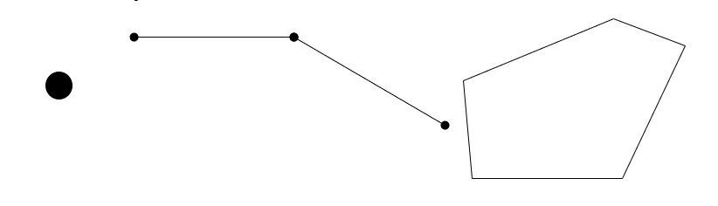
Vector Data
Vector Data
Made up of points, lines, and polygons
Better for presenting complex shapes

Slide 37
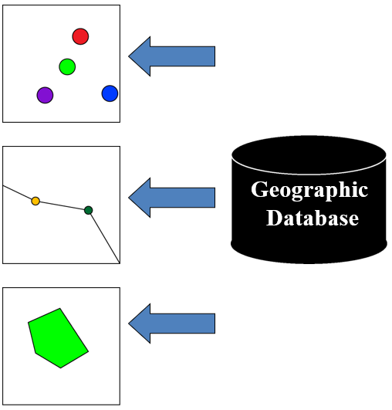
Abstraction of Real-World Entities
In a geographic database real world entities are abstracted into three basic shapes
Points:
facility locations
patient homes
fast food restaurants
Lines/arcs/routes
roads
rivers/streams
movements
Areas/polygons/regions
census geographies
State/county/city extents
lakes/ponds

Slide 38
Abstraction of Real-World Entities
Shapefile
Each shapefile consists of at least 3 files:
shapefile.shp;
shapfile.shx;
shapefile.dbf;
Shapefile.prj; spatial reference information (*.qpj for QGIS)
Shapefiles can contain one feature class
Attribute storage
No matter the feature type, a shapefile’s default attribute table is stored in a dBase format (.dbf)

Slide 39
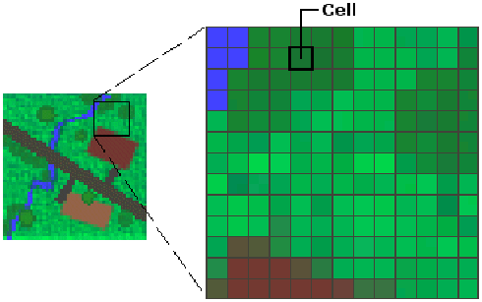
Raster Data
Raster Data
Made up of grid cells
Typically used for imagery

Slide 40
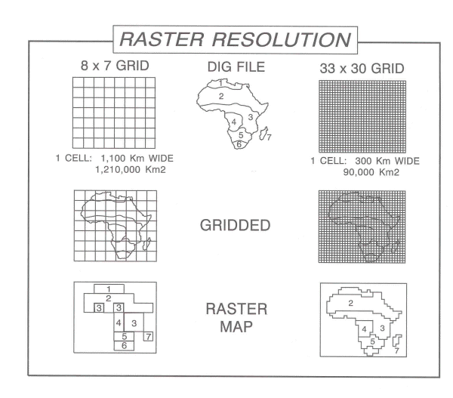
Data Format: Images and Grids
Sources of data:
Remote sensing
Scanned photos
Digital orthophotos
Rows and columns of equal sized cells
Each cell stores a value
Resolution depends on cell size
Images
tiff, bmp, sid, jpeg, ERDAS files
Grids (Arc native raster format)
Image vs. grid- function of the content of a pixel

Slide 41
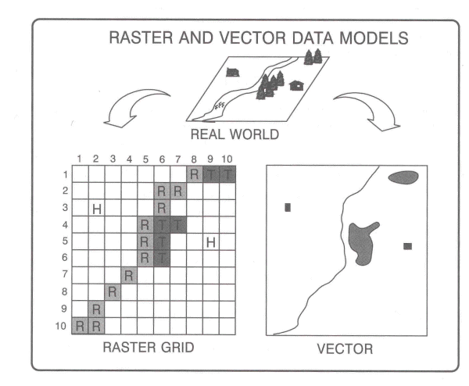
Vector vs. Raster
Two primary methods for digital storage
Vector formats discretely identify shape coordinates
Raster formats assign square cells to real world entities

Slide 42
Spatial Statistics - Spatial Autocorrelation -
Gyuhwan Kim

Slide 43
Spatial Autocorrelation
Complicated name, simple concept...
Expresses the amount of spatial dependence
How much proximity matters in spatial data
Correlation is the key notion
It indicates how much two properties vary together
Correlation in space
Is a variable in a location correlated with its values in nearby places?
Spatial + auto + correlation

Slide 44
Why Consider Spatial Autocorrelation?
Spatial autocorrelation suggests the operation of a spatial process
Additionally, most statistical analyses are based on the assumption that the values of observations in each sample are independent
Positive spatial autocorrelation violates this, because samples taken from nearby areas are related to each other and are not independent
In OLS, the correlation coefficients will be (1) biased and (2) their precision exaggerated (variance inflation)
Correlation coefficients may be higher than they really are, because the areas with higher concentrations of events will have a greater impact on the model estimate
Correlation coefficients are more likely to be found “statistically significant” (lower standard error: Type I error) because, since events tend to be concentrated, there are actually a fewer number of independent observations than is being assumed.
Thus, OLS and correlation are potentially deceiving in the presence of spatial autocorrelation
We need to adjust the data to remove the effects of spatial autocorrelation, then run the regressions again (spatial regression tomorrow)

Slide 45
ESDA for Spatial Autocorrelation
Visualization of spatial data
Global Indicators of Spatial Autocorrelation
Local Indicators of Spatial Autocorrelation (LISA)

Slide 46
Local and Global Analysis
Global
One statistic to summarize pattern
Clustering
Homogeneity
Local
Location-specific statistics
Clusters
Heterogeneity

Slide 47
Measures of Spatial Autocorrelation
Testing of Tobler’s first law of geography
Correlation of a variable with itself through space.
The degree to which characteristics at one location are similar (or dissimilar) to those nearby
Several measures available:
Join Count Statistic
Moran’s I
Geary’s C ratio
General (Getis-Ord) G
Anselin’s Local Index of Spatial Autocorrelation (LISA)
These measures may be “global” or “local”

Slide 48
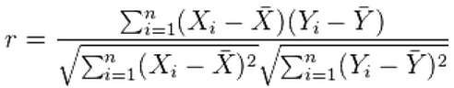

(Pearson’s) Correlation Coefficient
Pearson’s Correlation Coefficient (r): The square root of r2.
It is a measure of association between two interval-ratio variables.
Symmetrical measure: No specification of independent or dependent variables
Ranges from –1.0 to +1.0
The sign (±) indicates direction
The closer the number is to ±1.0, the stronger the association between X and Y.
$$r=\frac{\operatorname{cov}{(}X,Y)}{s.d.(X)∗s.d.(Y)}$$

Slide 49
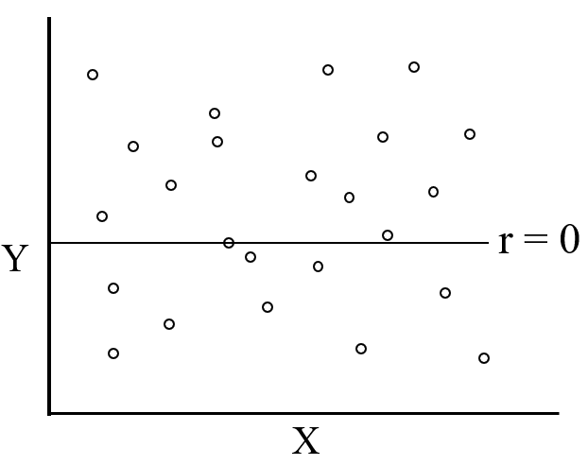
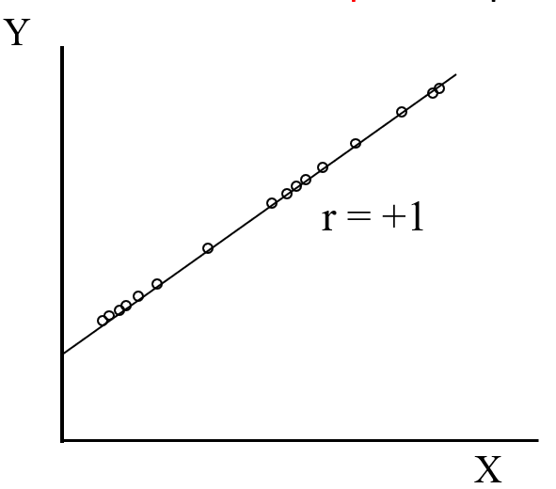
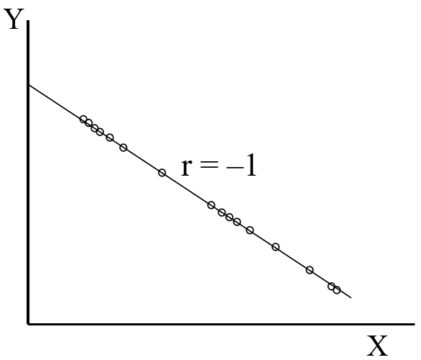
The Correlation Coefficient
r = 0 means that there is no association between the two variables.

Slide 50
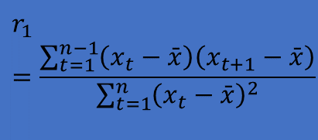
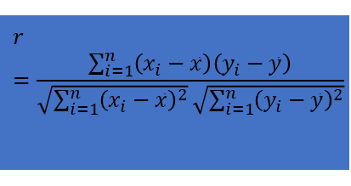
Autocorrelation (Temporal)
Correlation coefficient
{x_{i}} i=1,2,3…n, {y_{i}} i=1,2,3…n
Time series correlation model
{x_{t,1}} t=1,2,3…n‑1 and {x_{t,2}} t=2,3,4…n
Lag 1 autocorrelation:
$$r=\frac{\sum_{i=1}^{n}{\left(x_{i}−\bar{x}\right)\left(y_{i}−\bar{y}\right)}}{\sqrt{\sum_{i=1}^{n}{{\left(x_{i}−\bar{x}\right)}^{2}}}\sqrt{\sum_{i=1}^{n}{{\left(y_{i}−\bar{y}\right)}^{2}}}}$$
$$r_{1}=\frac{\sum_{t=1}^{n−1}{\left(x_{t}−\bar{x}\right)\left(x_{t+1}−\bar{x}\right)}}{\sum_{t=1}^{n}{{\left(x_{t}−\bar{x}\right)}^{2}}}$$

Slide 51
Spatial Randomness
Null Hypothesis: No Spatial Autocorrelation
Spatial randomness
values observed at a location do not depend on values observed at neighboring locations
observed spatial pattern of values is equally likely as any other spatial pattern
the location of values may be altered without affecting the information content of the data

Slide 52
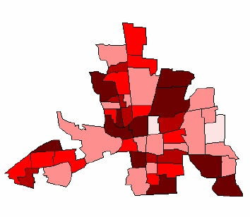
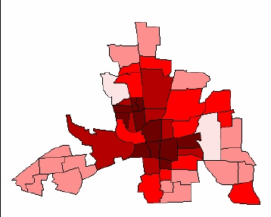
Random or Clustered?

Slide 53

Moving Averages (weighted average)
Local smoothing of attribute values
where:
Wij is the spatial weights matrix.
yi is the attribute value for each area.
n is the number of areas
$${\hat{μ}}_{i}=\frac{\sum_{j=1}^{n}{W_{ij}y_{j}}}{\sum_{j=1}^{n}{W_{ij}}}i=1,2,...,n$$

Slide 54
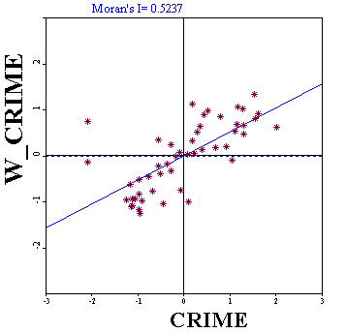
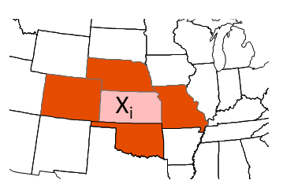
Moving Averages (weighted average)
Moran’s I can be interpreted as the correlation between variable, X, and the “spatial lag” of X formed by averaging all the values of X for the neighboring polygons
We can then draw a scatter diagram between these two variables (in standardized form): X and lag-X (or W_X)
Lag Xi is average of these

Slide 55
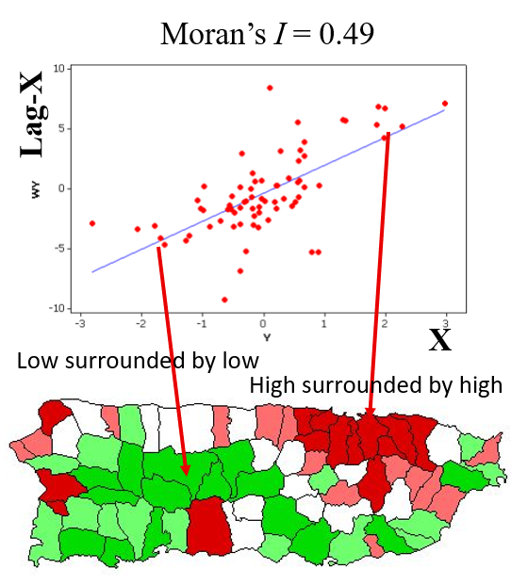
Moran Scatterplot: Example
Scatterplot of X vs. Lag-X
The slope of the regression line is Moran’s I

Slide 56
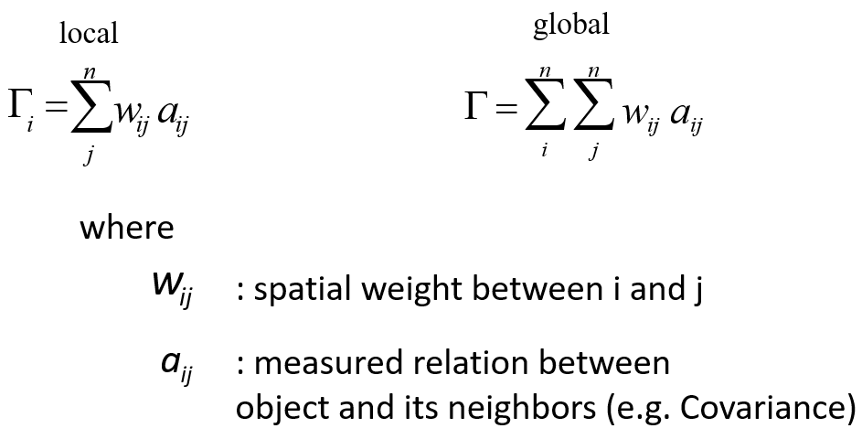
Spatial Randomness
Generic formulation:

Slide 57
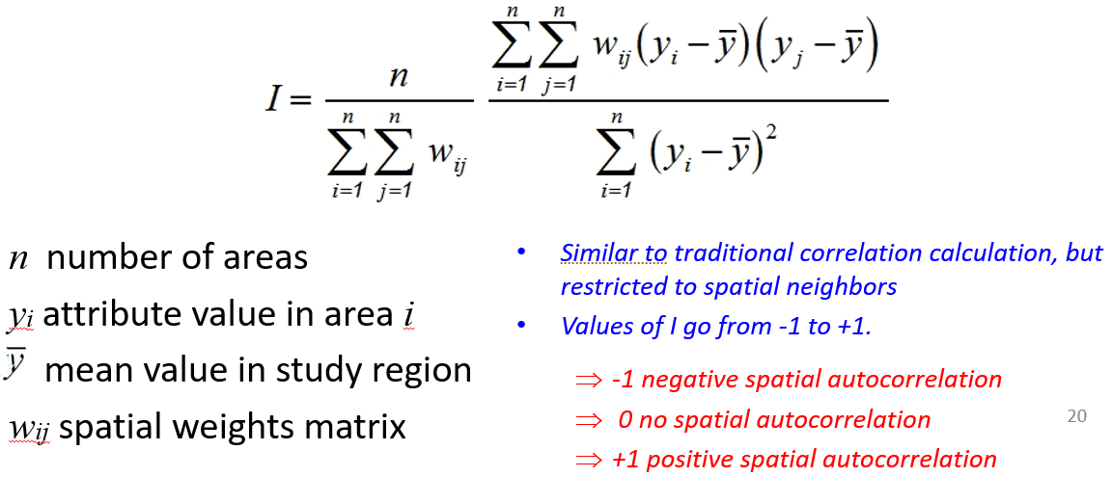
Global Indicators of Spatial Autocorrelation
Global Moran’s I:

Slide 58

Significance Testing for Moran’s I
Based on the normal frequency distribution with
There are two different formula for calculating the standard error
The normality (free sampling) method (assuming “normal” distribution)
The randomization method (“bootstrapping” or “conditional permutation”)
The hypothesis testing is carried out in the same way as usual
$$Z=\frac{I−E(I)}{Serror(I)}$$
I is the calculated value for Moran’s I from the sample
E(I) is the expected value if random
S is the standard error

Slide 59
Local Indicators of Spatial Autocorrelation (LISA)
Moran’ I is global
What if we want to find out the spatial correlation of each area?
Use a local indicator
Compares local value to that of its neighbours
LISA has two properties:
(1) Indicate significant spatial clustering for each location
(2) Sum of LISA’s is proportional to a global indicator of spatial association

Slide 60
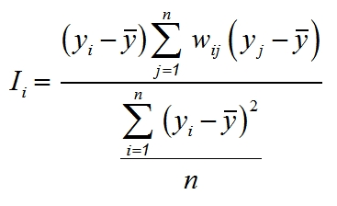
Local Indicators of Spatial Autocorrelation (LISA vs. Local Gi)
Local Moran’s I (for clusters)

Slide 61
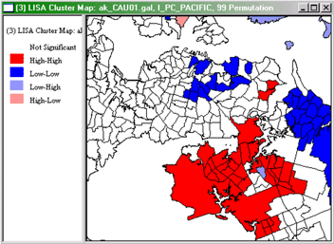
Local Moran’s I (Anselin 1995)
LISA identifies hot spots
Significant local clusters in the absence of global autocorrelation
Positive and high values (hot spots; high-high clusters)
Positive and low values (cold spots; low-low clusters)
Negative (cluster of dissimilar values; high-low or low-high)
Significant local outliers
high surrounded by low and vice versa
LISA indicates local instability
local deviations from global pattern of spatial autocorrelation

